Slide 1
Source Code: https://github.com/devilb2103/StockMarket-Portfolio-Prediction-Montecarlo-Sim---Antithetic-Variates
Hugging Face Model: https://huggingface.co/devilb2103/Pix2Pix-Hindi-Text2HT/tree/main
PORTFOLIO PRICING USING MONTE CARLO
AND DEEP LEARNING h

Slide 2
01
Problem & Solution

Slide 3
Problem Statement
In the financial industry, accurately predicting the future value of a stock portfolio is a significant challenge due to market volatility, external factors, and the stochastic nature of asset prices.

Slide 4
Objectives
We aim to develop models that accurately predict future stock portfolio values with minimal computational demands.
Employ multiple variance reduction techniques to enhance data quality and achieve faster convergence.
Use Bidirectional LSTM and GRU to train our model and predict future portfolio values and Day 1 allocations.

Slide 5
Software Requirements
Hardware Requirements
GPU T4*2 (15GB*2)
Intel(R) Xeon(R) CPU @ 2.30GHz
29 GB LPDDR5 Ram
Vs code
Pandas
Numpy
Scipy
Matplotlib
Yfinance
Cuda (12.4)
Nvcc
Pytorch

Slide 6
02
Monte Carlo Simulation

Slide 7
What is Monte Carlo Simulation?
Monte Carlo Simulation is a mathematical technique that predicts possible outcomes of an uncertain event. In this context, we use it to model the future performance of a portfolio under uncertainty[1].
What Do We Feed Into Monte Carlo Simulations:
Mean Returns (meanReturns): The average daily returns of the individual stocks.
Covariance Matrix (covMatrix): This represents how the returns of different stocks move relative to each other. It’s essential for modeling the interdependencies between the assets.
Cholesky Decomposition (L): To simulate correlated returns, we perform a Cholesky decomposition of the covariance matrix.
Random Normal Variables (Z): It is drawn from a standard normal distribution and, when combined with Cholesky decomposition, simulate daily returns based on historical statistical properties.”
Portfolio weights: It represent the proportion of the portfolio allocated to each stock and are crucial for calculating overall portfolio returns in each simulation

Slide 8

Formula of MC
St​ is the stock price at time t
μ is the mean daily return
σ is the daily volatility
Z is a random variable sampled from a standard normal distribution N(0,1)

Slide 9
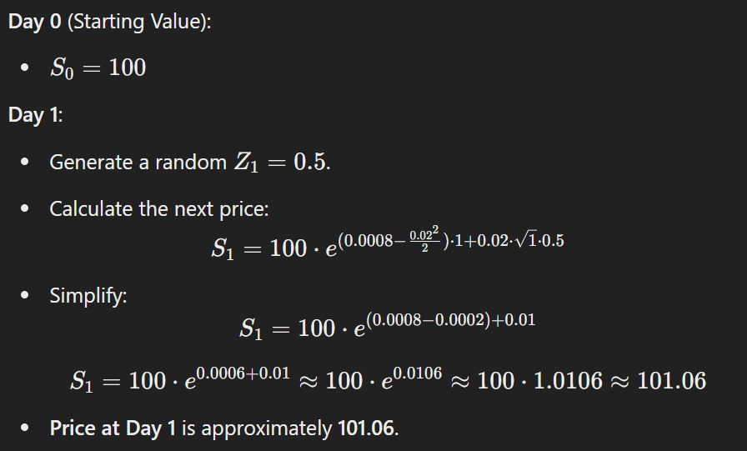
Monte Carlo Example

Slide 10

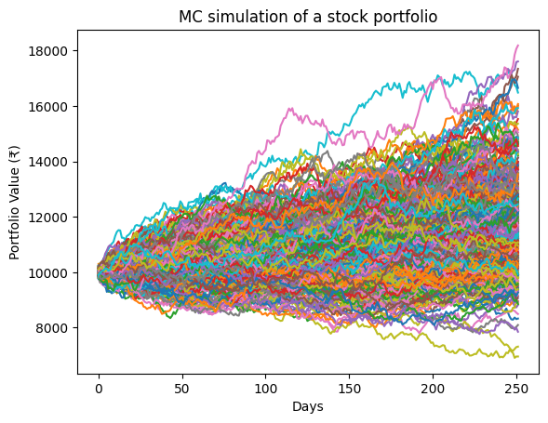
Monte Carlo Portfolio Generation
100000 Monte Carlo simulation for a stock portfolio over a 252-day period (approximately one trading year)
Each colored line represents a different simulation, showing how the portfolio value evolves over time based on different random paths.
The initial portfolio value is ₹10,000, and the simulation considers market volatility
The portfolio values vary widely across different simulations, reflecting the inherent uncertainty in financial markets.

Slide 11
Understanding the Role of Monte Carlo Simulations
01
03
02
Data Augmentation:
Risk Management:
Problem: Real historical data might be limited, especially in finance, where only a few years' worth of data might be available.
Monte Carlo Solution: Monte Carlo simulations generate synthetic data that mimic the statistical properties of real data (like mean returns and volatility)[1]. This augments your dataset, providing a vast amount of additional data points to train the LSTM.
Problem: Bidirectional LSTM and GRU models need to be aware of potential risks and market behavior under different conditions
Monte Carlo Solution: By training on a variety of simulated scenarios, the Bidirectional LSTM and GRU models we can better capture the risks associated with different market conditions, helping it to make more informed predictions[1].
Scenario Generation:
Problem: Real market conditions may not cover all possible future scenarios, especially extreme events or rare occurrences.
Monte Carlo Solution: Simulations can generate a wide range of possible future paths, including rare or extreme market conditions[1].

Slide 12
03
VARIANCE REDUCTION TECHNIQUES

Slide 13
What are Antithetic Variates?
Antithetic variates are used to reduce the variance of Monte Carlo simulations by pairing each random variable with its antithetic counterpart (i.e., its negative). This technique helps in obtaining a more stable and accurate estimate. It refers to simulated values that are not independent but are negatively correlated.[2]
The basic idea is to introduce negative correlation between pairs of simulated paths to counterbalance the errors in one path with those in its "antithetic" pair.
How It Reduces Variance
Balancing Effects: Positive errors in one path are offset by negative errors in its antithetic pair, leading to a more stable estimate.
Negative Correlation: The original and antithetic paths are negatively correlated. This negative correlation tends to cancel out the fluctuations in the estimators, leading to a reduction in the overall variance
Faster Convergence: Because the variance is reduced, the estimate converges more quickly to the true value with fewer simulations. This allows for more efficient computation

Slide 14
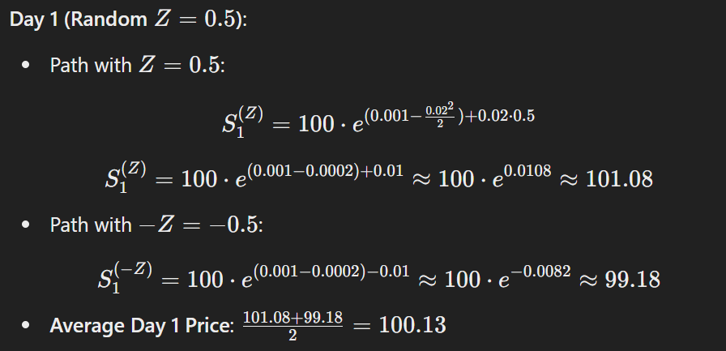
Antithetic Variate Example

Slide 15
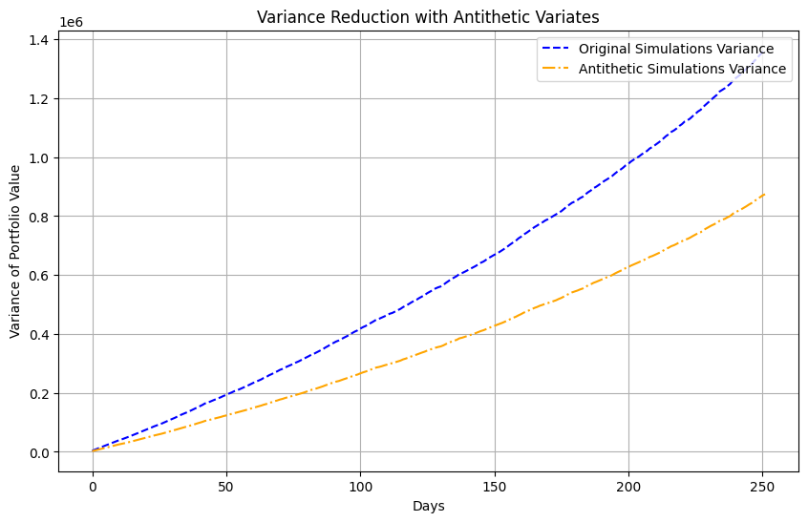
Antithetic variates helps in variance reduction

Slide 16
Our Process and Solutions
Data Collection
01
Using y finance to scrape data from national stock exchange (nse) majorly stocks from nifty 50.
Calculating daily returns, mean returns, and covariance matrix.
Monte Carlo Simulation
02
Generating synthetic portfolio values by running multiple Monte Carlo simulations.
Incorporating variance reduction techniques (Antithetic Variates) to reduce computation.

Slide 17
Our Process and Solutions
Data Preprocessing
Model Training
03
04
Normalize and structure the simulated data for input into the LSTM model.
Split the data into training and testing sets.
Feed the processed data into the Bidirectional LSTM and GRU model.
Train the model to predict future portfolio values and Day 1 stock allocations to get those future portfolio values based on the input sequence.
Prediction and Evaluation
05
Use the trained model to predict portfolio values and Day 1 stock allocation over the desired time horizon.

Slide 18
04
Real-Time Portfolio Pricing (LSTM AND GRU)

Slide 19
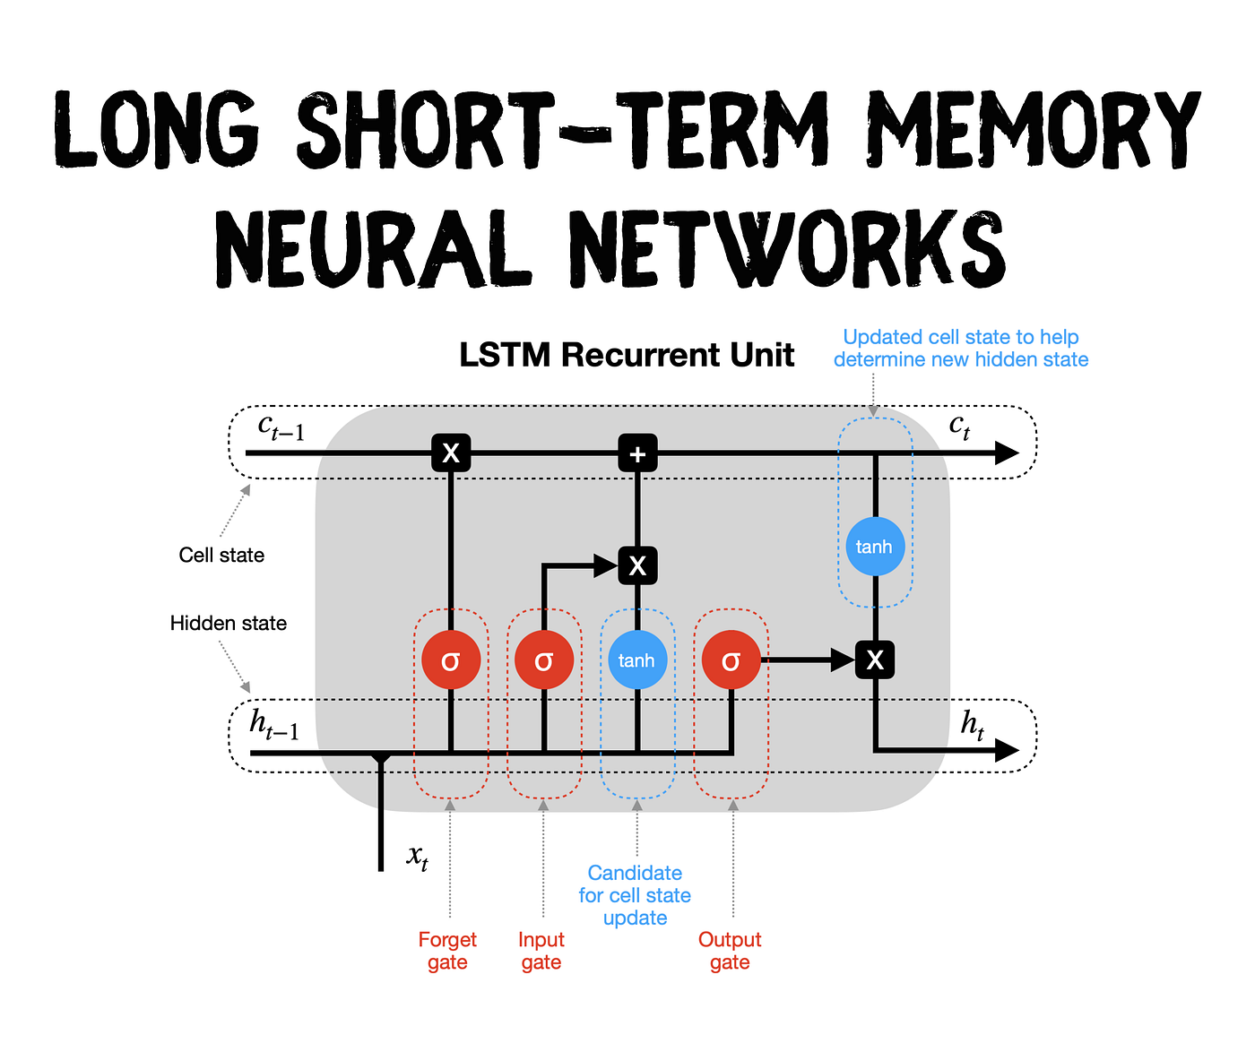
What is Bidirectional LSTM?
Why Bidirectional LSTM?
LSTMs i.e. Long Short-Term Memory is a type of RNNs Recurrent Neural Network that can detain long-term dependencies in sequential data. LSTMs are best suited to process and analyze sequential data, such as time series, text, and speech.[3]
As Stock market analysis is a type of Time series analysis,hence LSTM is selected.[4] (for comparatively long term context)

Slide 20
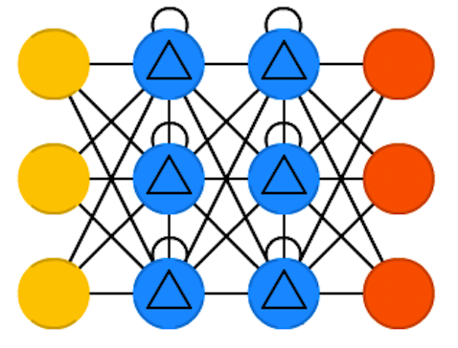
What is Bidirectional GRU?
Why Bidirectional GRU?
The Bi-directional GRU (Gated Recurrent Unit) is similar to the Bi-directional LSTM but uses the GRU architecture instead of LSTM. GRUs are a simplified version of LSTMs, combining the forget and input gates into a single "update" gate and removing the output gate.They are generally faster and less computationally intensive than LSTMs.
As Stock market analysis is a type of Time series analysis,hence GRU is selected. (for short term context)

Slide 21
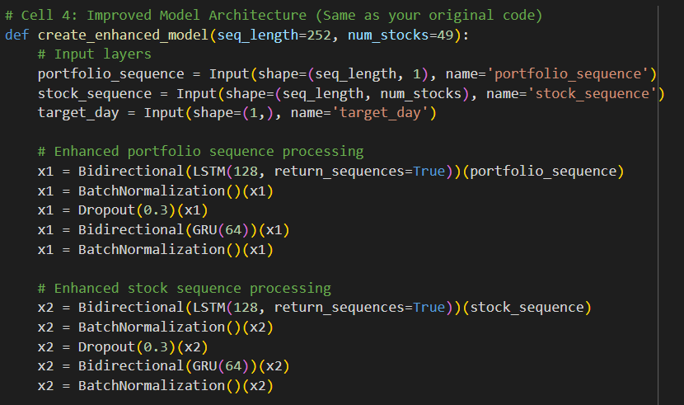
Code Snippets

Slide 22
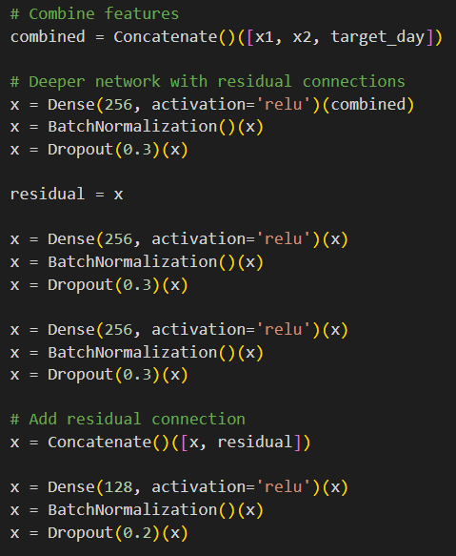
Code Snippets

Slide 23
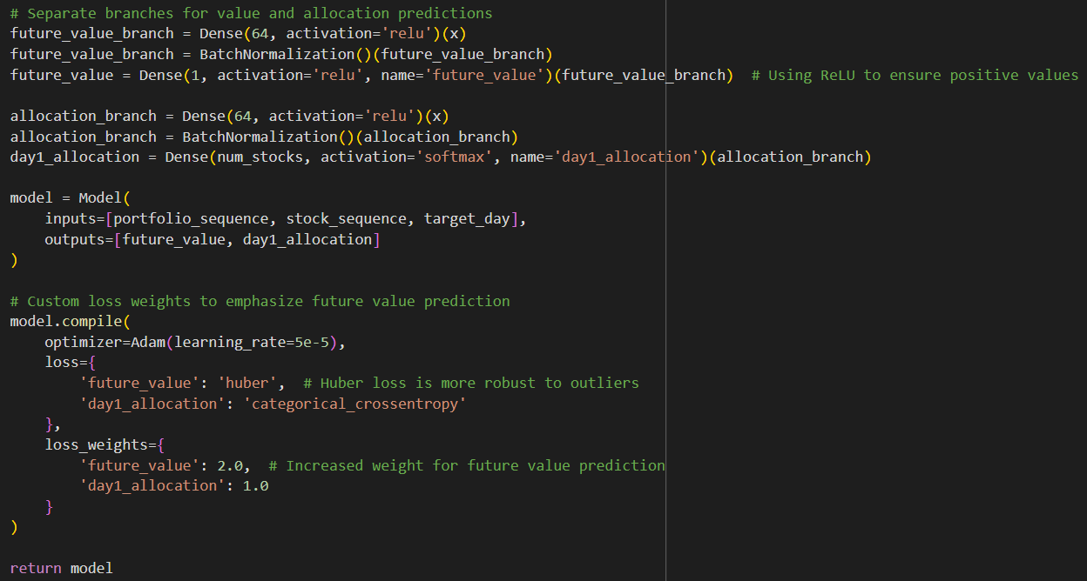
Code Snippets

Slide 24
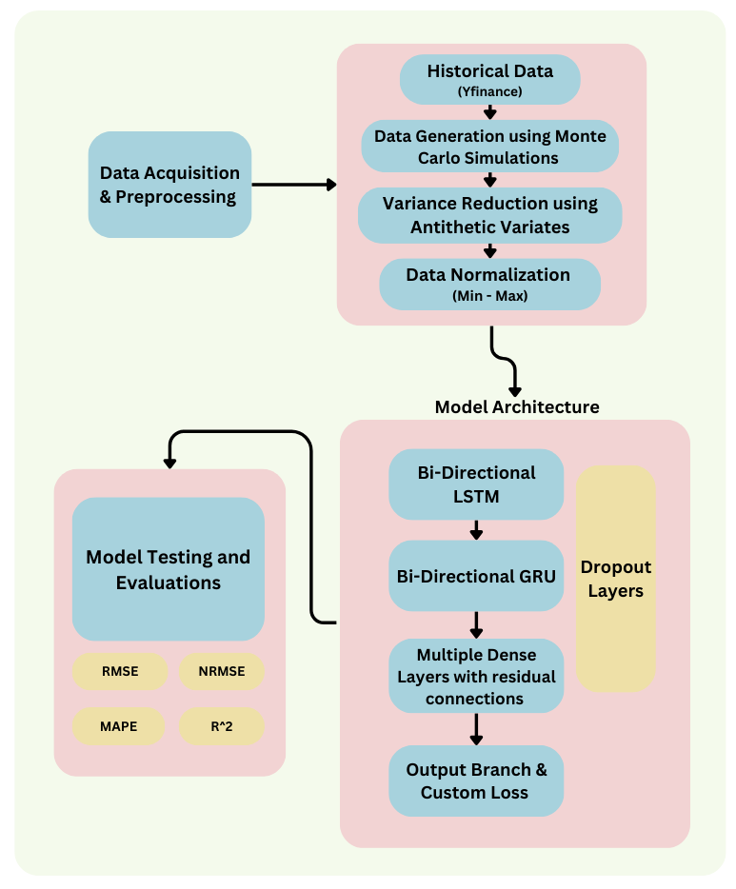
Methodology of the project

Slide 25
Output Calculation
We collected 200 days of real historical data from Yahoo Finance for your selected stocks. This buffer data represents the actual performance of your portfolio over the 200 days.
The model, which was trained using past sequences and stock allocations, makes predictions for the future portfolio values and stock allocations. Specifically, the model tries to forecast how the portfolio value and allocations will evolve over the prediction horizon (e.g., days 253 to 365).
To evaluate the accuracy of these predictions, we compare them with the 200 days of real market data.

Slide 26
Output Calculation
The output shape from the model predictions was from day 252 to day 366, providing predictions over a 114-day period.
The input buffer data retrieved from Yahoo Finance also covered days 252 to 366.
This alignment ensured that your predictions and the real market data over this period could be directly compared to calculate performance metrics like RMSE, NRMSE, MAPE, and R².

Slide 27
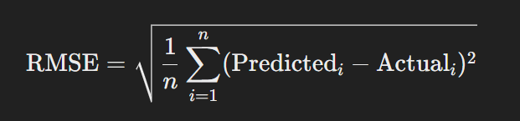
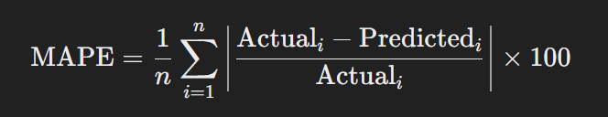
Output Results / Performance Metrics
RMSE (Root Mean Squared Error): Measures the average magnitude of errors. Result: 0.0944
NRMSE (Normalized Root Mean Squared Error): RMSE normalized by the range or mean of actual values. Result: 0.1218
MAPE (Mean Absolute Percentage Error): Measures the average percentage errors. Result: 17.85%
R² Score (Coefficient of Determination): Indicates the proportion of the variance in the dependent variable that is predictable. Result: 0.4721

Slide 28
ThankYou

